Slide 1

The Machine Learning Process
How do I change the data type
of a pandas Series?
Dr. Reza Dibaj

Slide 2
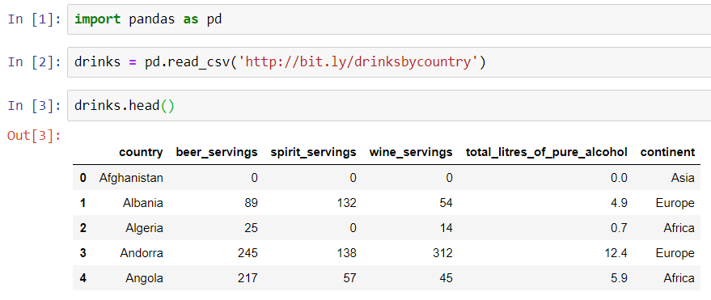
Changing the data type of a pandas Series
Let’s pull up an example dataset as follows:
Notes:
import pandas as pd
drinks = pd.read_csv('http://bit.ly/drinksbycountry’)
drinks.head()

Slide 3

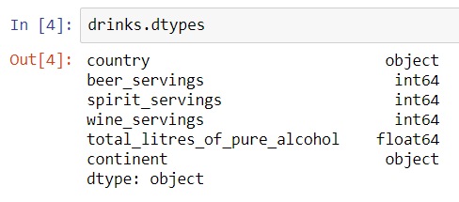
Changing the data type of a pandas Series
In order to check the data type of each column, we use the dtypes attribute as follows:
Now, imagine we want to convert the beer_servings Series into a float.
Notes:
drinks.dtypes

Slide 4
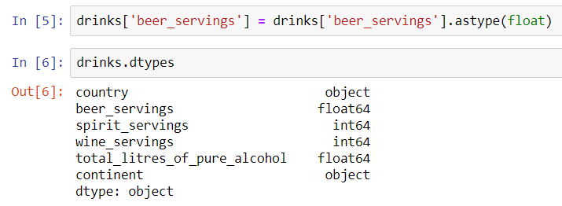
Changing the data type of a pandas Series
To convert the beer_servings Series which is integer into a float we use astype method as follows.
Notes:
drinks['beer_servings'] = drinks['beer_servings'].astype(float)
drinks.dtypes

Slide 5

Group Discussion
Please spend a few minutes with your team members and try to find a real use case for type changing. It would be great to share some examples :)

Slide 6
Question for Reza…
Q: Reza! How can we define the type for each column before reading the csv file?
R: Yes! We need to change the data type(s) during the csv reading process. Let’s see the next example to clarify more.

Slide 7
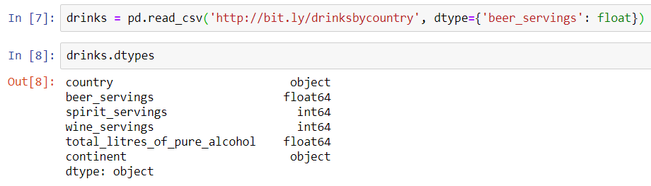
Changing the data type of a pandas Series
Here is how we typecast an integer into floating during the reading csv file process:
Key
Value
Dictionary
Result
Notes:
drinks = pd.read_csv('http://bit.ly/drinksbycountry', dtype={'beer_servings': float})
drinks.dtypes

Slide 8

Question for Reza…
Q: Reza! It was not a useful example… What could be the real use case?
R: Yes! When we have a column that numbers are stored as strings and we want to do math on them.…
Q: Forget it Reza! I will google it by myself….
R: Please wait a minute and we will learn this concept within an example.

Slide 9
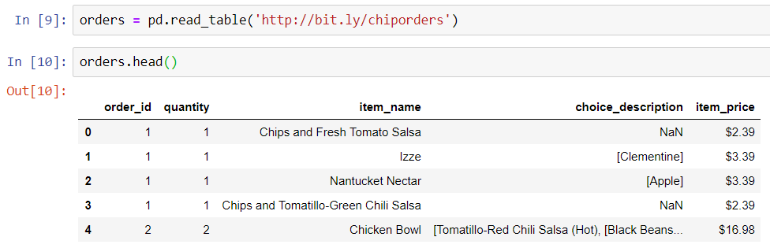
Changing the data type of a pandas Series
Let’s pull up another sample dataset as follows:
Notes:
orders = pd.read_table('http://bit.ly/chiporders’)
orders.head()

Slide 10
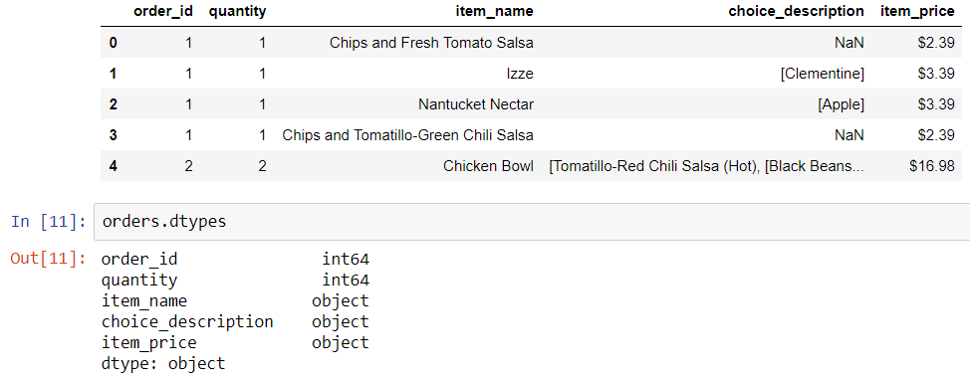
Changing the data type of a pandas Series
And we want to calculate the average for the item_price column, so we need to convert it from string to float.
Notes:
orders.dtypes

Slide 11
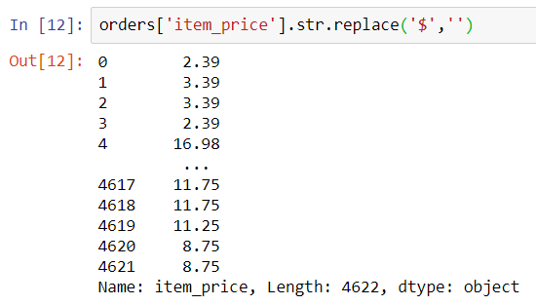
Changing the data type of a pandas Series
The first step would be removing the $ sign from the string in each row. For that aim we need to use string methods as we learned before.
Notes:
orders['item_price'].str.replace('$',‘’)

Slide 12
Group Discussion
Please spend a few minutes with your team members and discuss if the modified column is ready for the math?

Slide 13
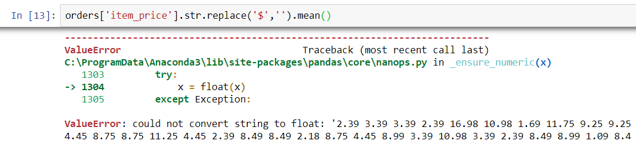

Changing the data type of a pandas Series
If we directly try to calculate the mean, it will give us error, as it is the column type is still string.
First, we need to do typecasting and then do calculating as follows:
Notes:
orders['item_price'].str.replace('$','').mean()
orders['item_price'].str.replace('$','').astype(float).mean()

Slide 14

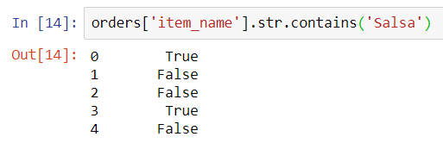
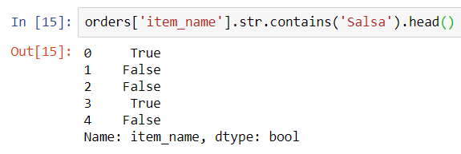
Bonus Tip
Many a time, we need to convert Booleans (True and False) into 1 and 0 accordingly.
As we studied before, imagine we want to check if the item_name column contains Salsa or not. So, the result would be a number of False or True values as follows:
OR
Notes:
orders['item_name'].str.contains('Salsa’)
orders['item_name'].str.contains('Salsa').head()

Slide 15
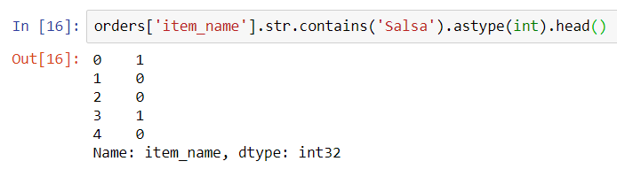
Bonus Tip
Simply, we need to add astype(int) as follows and it will work fine:
Notes:
orders['item_name'].str.contains('Salsa').astype(int).head()

Slide 16
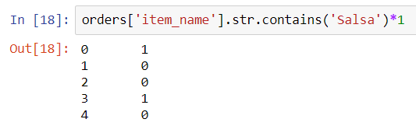
Group Discussion
Please spend a few minutes with your team members and discuss if you recommend the following shortcut or not…Why yes? Why no?
Notes:
In MATLAB it is a nice trick… Here, we should be careful using it.
orders['item_name'].str.contains('Salsa’)*1
This one does not work and need parathesis ➔ orders['item_name'].str.contains('Salsa')*1.head()
(orders['item_name'].str.contains('Salsa')*1).head()

Slide 17

Thank you
Question?
To be
Not to be

